Slide 1

Coupa Approver Training

Slide 2
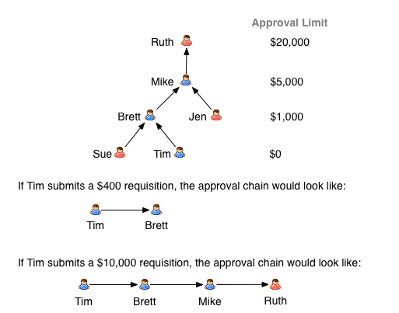
APPROVALS OVERVIEW
Every Coupa user is assigned another Coupa user as their next approver.
When a user submits a purchase requisition or an invoice exceeds tolerance, an approval chain is generated based on its value.
If an approver has the necessary financial delegation of authority (DOA), they can approve it. Otherwise, the requisition or invoice escalates to their manager, continuing up the chain until it reaches someone with the required DOA level.
123
Approval limits in Coupa
Example:

Slide 3
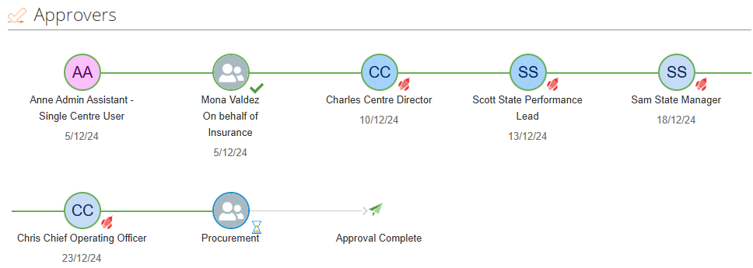
VIEWING APPROVER INFO
You can view the approval chain at any time at the bottom of each transaction, including requisitions, PO changes, and invoices. Icons indicate who has already approved the transaction and who is currently reviewing it.
123
The tick shows that this approver has already approved
The rocket shows that the request escalated past this approver
The hourglass shows who the request is currently with for approval

Slide 4




APPROVAL METHODS
123

Slide 5
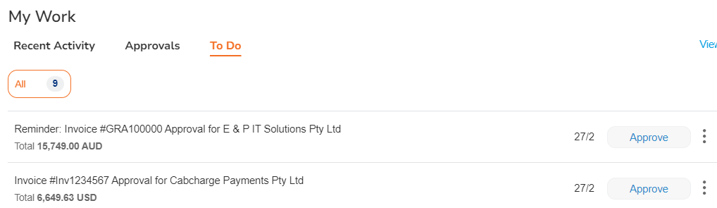
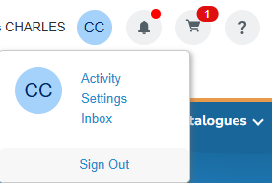
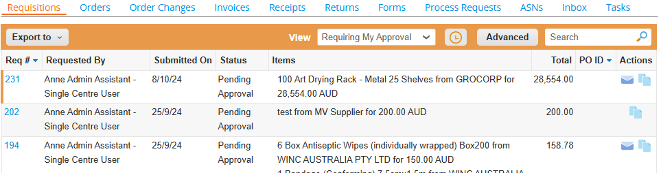
APPROVAL VIA COUPA WEB
In Coupa, you can find the item awaiting approval through one of the following methods:
  My Work (Approvals or To-Do List) on your homepage – Click Approve to approve the item. To view more details or access additional options like Reject or Hold, click the three dots.
  Activity – Navigate to Requisitions or Invoices as needed and adjust the view to Requiring My Approval.
123
1
2

Slide 6
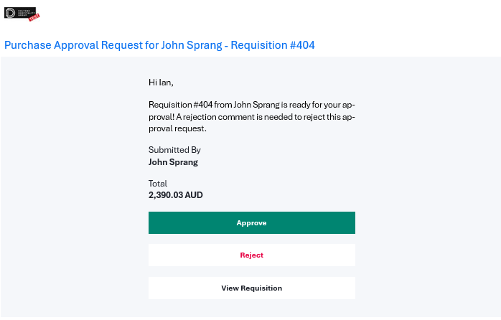
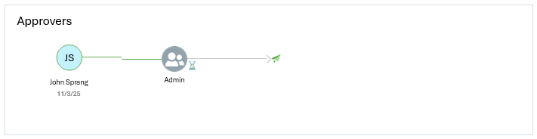
APPROVAL VIA EMAIL
123
If a purchase request or invoice requires your approval, you will receive an Approval Request email notification containing details about the request or invoice.
From this email, you can:
View – Open Coupa to review the document.
Approve – Open an email to approve the request.
Reject – Open an email to reject the request (a comment is required).
The approval chain is also visible within the email notification, so you can see who has already approved the request and who it is currently assigned to.

Slide 7
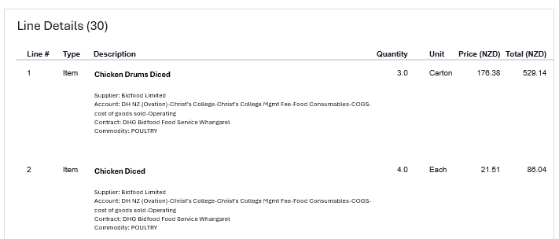
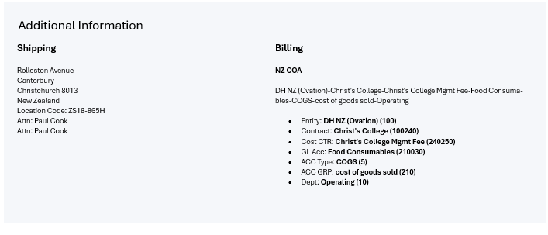
APPROVAL VIA EMAIL
123
Additional details about the requisition or invoice are included in the email notification, so you don’t need to open Coupa to review them.
Key information such as line items, billing details, and shipping information is readily available, allowing you to make an informed decision on whether to approve or reject the request without navigating into the system.

Slide 8
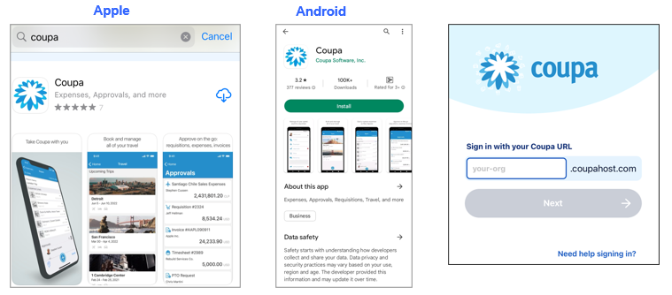
APPROVAL VIA MOBILE
Download the Coupa app from your mobile app store, whether it's the iPhone App Store or Google Play Store.
Once installed, enter the relevant Coupa instance name, 'DHG,' and click Next to proceed.
123

Slide 9
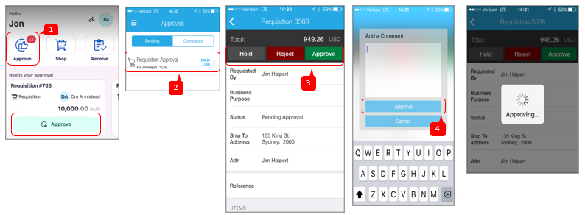
APPROVAL VIA MOBILE
To approve or reject a request using the Coupa mobile app, follow these steps:
Open the Coupa mobile app and navigate to the Approve section.
Locate and select the relevant requisition or invoice that requires your approval.
Choose from the available options: Hold, Reject, or Approve.
If needed, add a comment before finalizing your decision, then click Approve.
Once submitted, Coupa will process the approval or rejection, and the request will be automatically removed from your To-Do List.
123

Slide 10
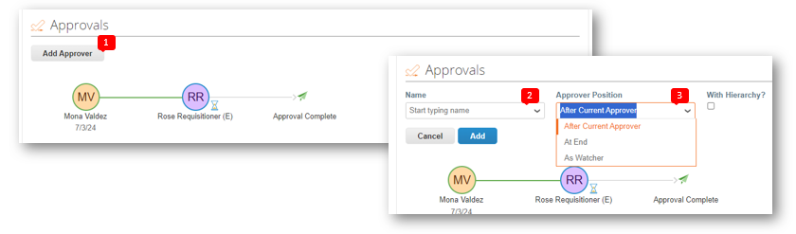
ADDING APPROVERS
If an invoice or requisition has been assigned to you for approval based on the Delegation of Authority (DOA), but you believe it should be reviewed by someone else, you can add an approver directly from the online view.
To add an additional approver:
Open the invoice or requisition online and select Add Approver.
Enter the name of the new approver.
Choose their placement in the approval chain.
123
Please note, even though you are adding another approver, you will still be required to approve the invoice for it to proceed.

Slide 11
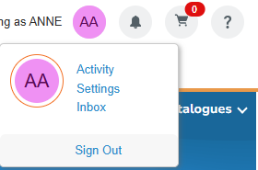
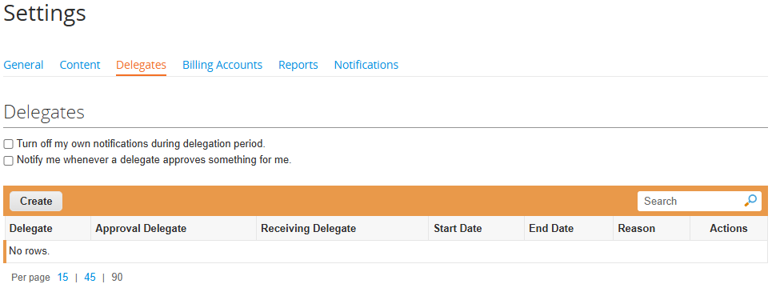
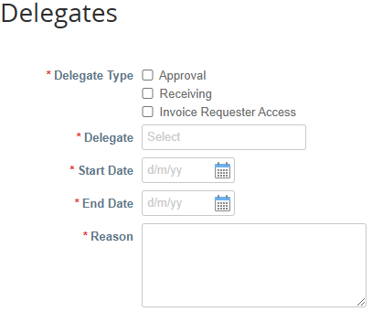
DELEGATES
This section allows you to assign a delegate to act on your behalf, provided they are active in Coupa and align with your company’s Delegation of Authority (DOA).
The delegate will have the ability to approve transactions and receipt items that are routed to you within the selected timeframe. Both you and the delegate will receive approval notifications once the delegation period begins. If you do not reassign your approvals or receipting, they will remain in your inbox until action is taken.
123

Slide 12
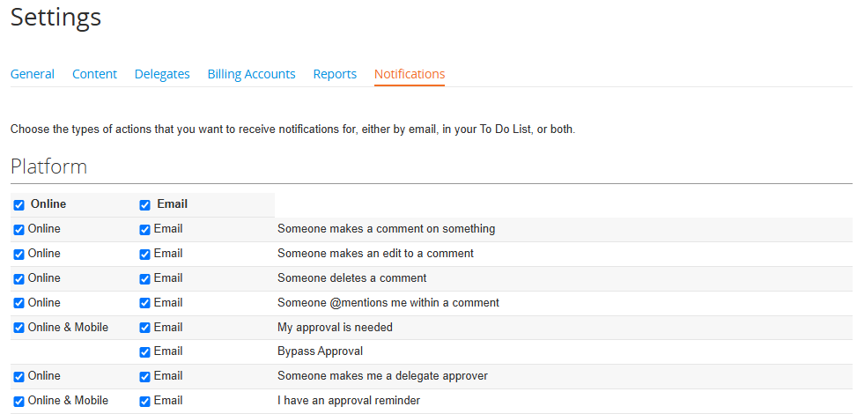
NOTIFICATIONS
Users can customize their notification preferences by choosing to receive alerts online, via email, or both for specific actions within Coupa modules, such as Requests, Orders, and Catalogs.
Note: If you disable notifications, you may miss important updates, which could delay workflows and approvals.
123

Slide 13
Q&A / RESOURCES
123
💬 Have questions? Feel free to ask!
Need further assistance? Reach out to us for help.
Support Contacts: 📌 Ian @ Ian.Lai@Doltonehouse.com.au
📌 Diana @ Diana.Imtiaz@Doltonehouse.com.au

