Slide 1

Coupa Requisitioner Training

Slide 2
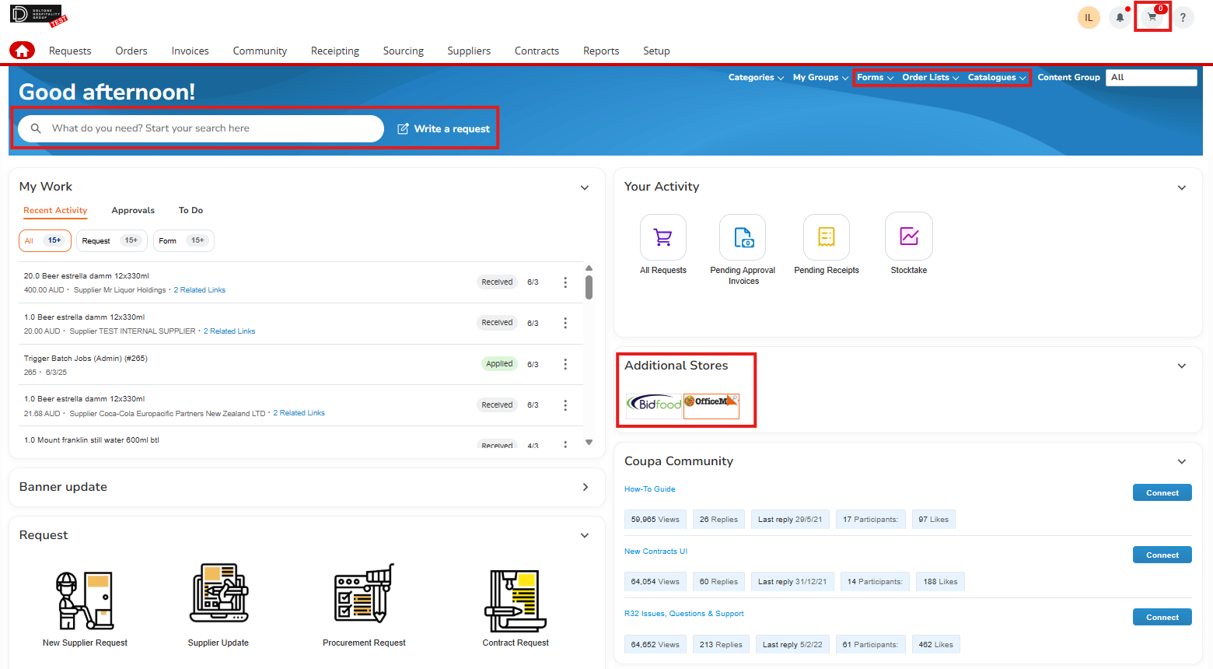

OVERVIEW: HOMEPAGE
123
HOME BUTTON: This icon will bring you back to the homepage screen
WHAT DO YOU NEED: This is your search function
NOT SURE? LET US GUIDE YOU: Create your requisition for Non-Catalogue Items (Write a Request)
BASKET: This is where your Requisitions are stored until you are ready to proceed
FORMS, ORDER LISTS, CATALOGUES: Displays various ordering and information options available in the system
ADDITIONAL STORES: Displays all punchout catalogues
MY WORK -> RECENT ACTIVITY: This area will display your recent orders/req’s
MY WORK -> APPROVALS: This area will display any approvals waiting your action
MY WORK -> TO DO: Displays a list of action items within Coupa assigned to you
ANNOUNCEMENTS: useful tool that enables clear communication across the business and content can be controlled by user content groups.
YOUR ACCOUNT (User-Name): This is where you can access all the information in your account, make profile changes, delegate authority and view your inbox
Tabs available at the top of your screen will vary with User permissions

Slide 3
REQUISITIONING METHODS
123
Supplier Catalogues
Use Supplier Catalogues to browse and select items directly from preferred suppliers. This is useful when you know which supplier provides the product(s) you need.
Navigate to the Supplier Catalogues section.
Select a supplier to view their available products.
Browse the catalogue or use the search function to find the required item(s).
Adjust the quantity as needed and click ‘Add’ to add the item(s) to your basket.
Once added, you can proceed with the requisition submission process.

Slide 4
REQUISITIONING METHODS
123
Additional Stores - Punchouts
Use Punchout Catalogues to select items directly from a supplier’s website and return them to your Coupa basket. This method allows you to browse supplier-specific offerings and complete selections externally before finalizing in Coupa.
Navigate to the Additional Stores section.
Click on the relevant supplier tile to access their website.
Select the required items and proceed through the checkout process (note that checkout steps may vary by supplier).
After checkout, you will be redirected to Coupa, where your selected items will appear in your basket.
Once added, you can proceed with the requisition submission process.

Slide 5
REQUISITIONING METHODS
123
Shopping by Search
Use the Search Bar to find items across all supplier catalogues. This is helpful when you are unsure which supplier provides the product(s) you need.
Click into the Search Bar and enter the product name or keywords.
A results page will display all available options related to your search.
Locate the required item(s), adjust the quantity as needed, and click ‘Add’ to add them to your basket.
Once added, you can proceed with the requisition submission process.

Slide 6
REQUISITIONING METHODS
123
Order Lists
Use Order Lists to quickly purchase a bundle of frequently ordered products, such as first aid kit items.
Navigate to the Order Lists section and select the required list.
Adjust the quantity for each item as needed.
Scroll to the bottom of the screen and click ‘Add to Basket’ to add all selected items.
Once added, you can proceed with the requisition submission process.

Slide 7
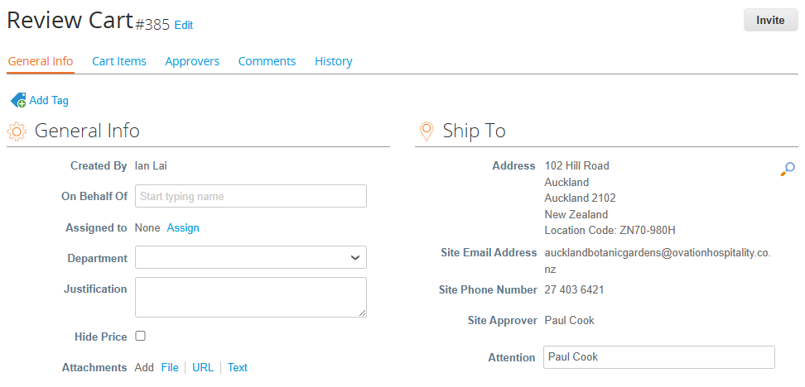
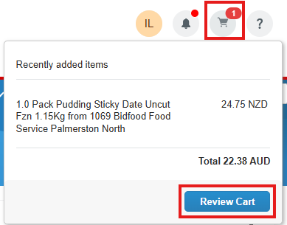
SUBMITTING A REQUISITION
Once you have selected all items, navigate to your shopping cart from the home page and click ‘Review Cart’. This will take you to the Review Cart page, where you can finalize your purchase(s).
123
1
2
The General Info section includes key details such as the requester, purchase type, "On Behalf Of" user, and any necessary attachments. If you have access to the On Behalf Of field, select the user for whom you are making the purchase. They receive a notification, and their Ship To Address and approval hierarchy will be applied.
The Ship To address will automatically populate based on your location. However, multi-site users can modify this by clicking the magnifying glass icon to select a different address if needed.

Slide 8
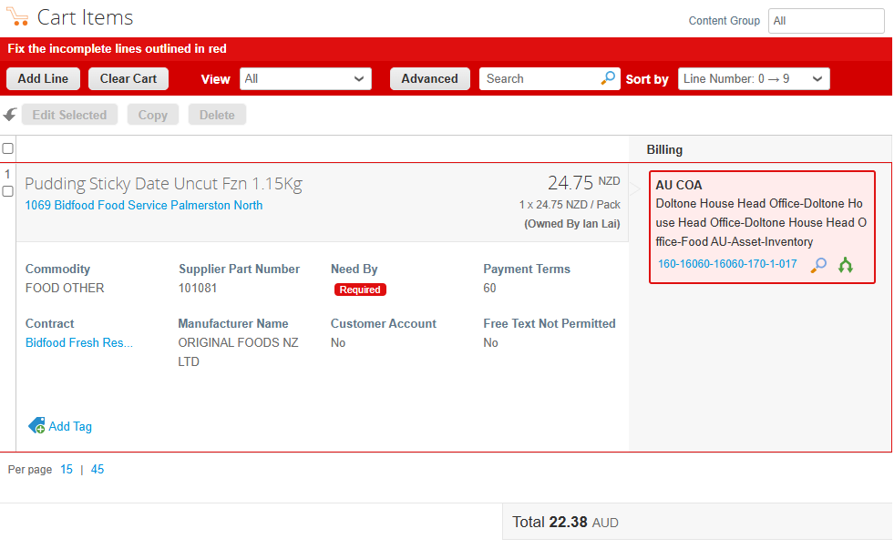
SUBMITTING A REQUISITION
123
Click Add Line or Delete to modify the items in your cart directly from the basket screen.
Each line item contains details about the selected products. To make changes, simply click anywhere within the line.
The Billing section displays the assigned cost center and GL code for your purchase. While this populates automatically, you can update each line’s billing information if necessary. For most requisitions other than Standard Order, this will need to be confirmed manually. To do this, click the magnifying glass icon and select the appropriate option.
3
4
5

Slide 9
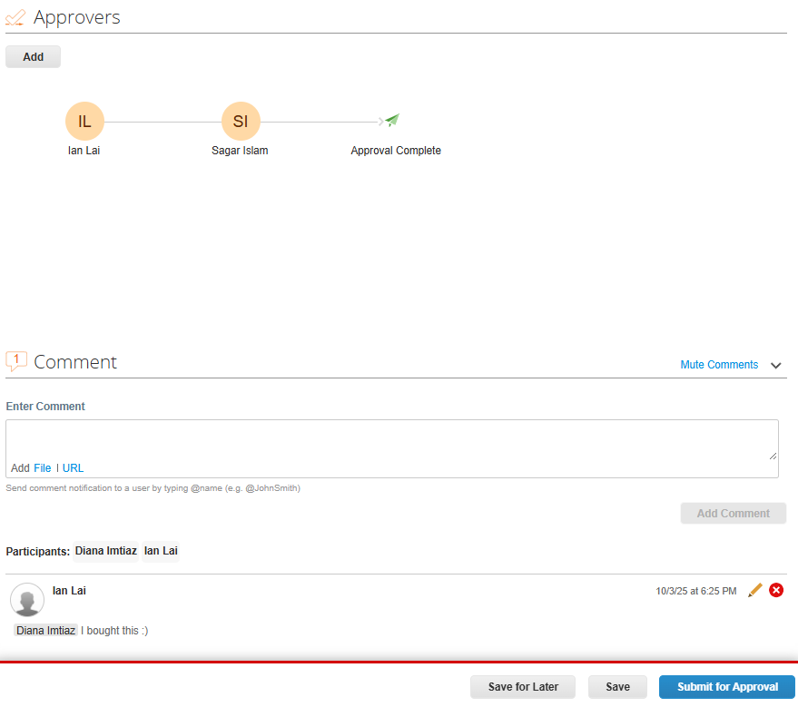
SUBMITTING A REQUISITION
123
Approvers are automatically assigned based on approval rules, but users can add additional approvers or watchers at any point in the approval chain.
Comments allow communication with other Coupa users. To tag someone, type @ followed by their name and select them from the dropdown list. Note: Only Coupa users can be tagged.
Requisitions can be:
  Saved for Later (removes items from the cart)
  Saved (keeps items in the cart)
  Submitted for Approval (sends for approval processing)
6
7
8

Slide 10
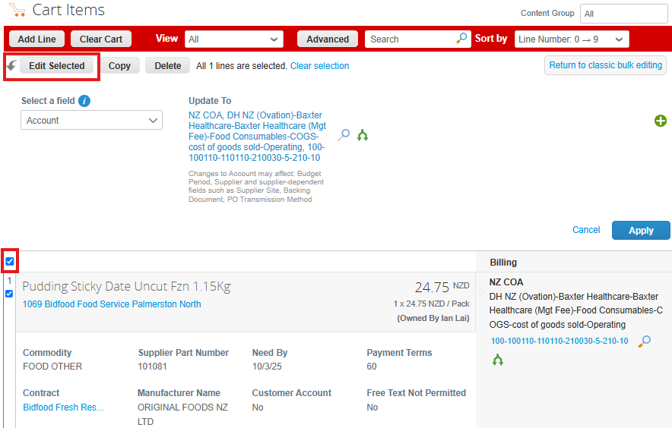
REQUISITIONS – EDITING MULTIPLE LINES
123
2
Select Items – Click the checkbox at the top to select all lines.
Edit Selection – Click "Edit Selected" to open the bulk edit options.
Choose a Field – Select the field you want to update (e.g., Billing String, Delivery Date, Non-Purchasable Reason, Supplier), make your edits and press apply.
3
1

Slide 11
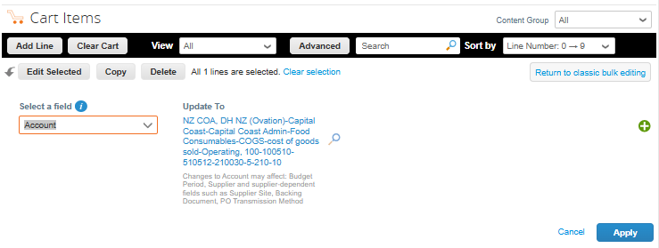
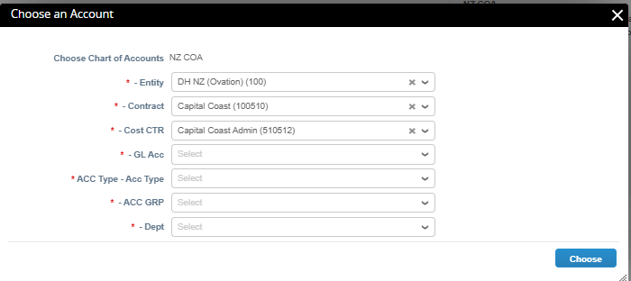
REQUISITIONS – BILLING STRINGS
123
For most non-Standard Order purchase types, the Billing String must be updated. Follow these steps to ensure accuracy:
Select All Lines – Choose all requisition lines as shown in the previous slide.
Open Account Selection – In the Account section, click the magnifying glass icon.
Choose the Correct GL Code – In the Choose an Account box, start typing the desired GL segment and select the correct number. Click Choose.
Apply Changes – In the Adjust popup, click Apply. All selected lines will now reflect the correct Billing String for the chosen Purchase Type.

Slide 12
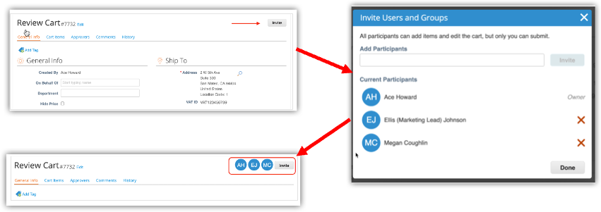
REQUISITIONS – GROUP CARTS
123
A Group Cart allows multiple users to contribute to a requisition. The cart owner is the person who created it, while invited users receive a notification to join.
Invited users can edit the cart, which activates it in their own shopping cart.
Items added by different participants will be labeled with the contributor's name.
Only the owner can add or remove participants.
Only the owner can submit the requisition for approval.

Slide 13
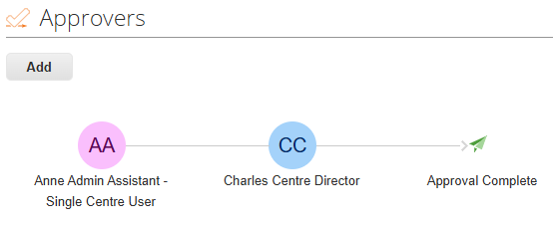
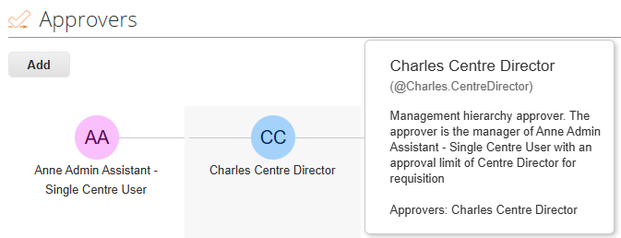
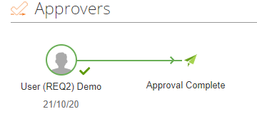
REQUISITION APPROVALS
123
In the Approvals section, you can view all required approvers for the requisition.
Approvers are automatically assigned based on your company’s approval rules.
Users can click ‘Add’ to include additional Approvers or Watchers at any point in the approval chain.
System-generated approvers cannot be removed.
To see why an approver was added, hover over their name to display their position, group, or authority.

Slide 14
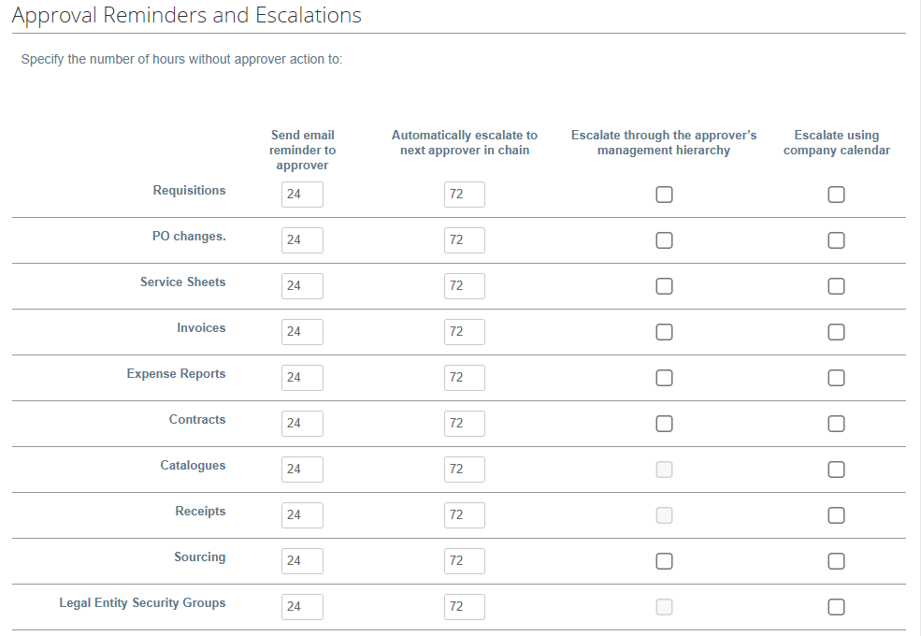
APPROVAL ESCALATIONS
123
Escalations in Coupa ensure that approval requests are not delayed.
If an approver takes no action within 24 hours, they will receive a reminder email.
If the request remains unapproved after 72 hours, it will escalate to the next approver in chain for action.

Slide 15
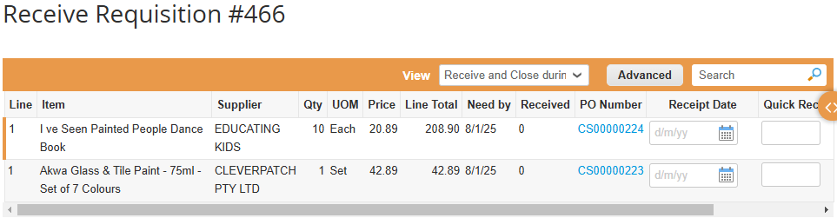
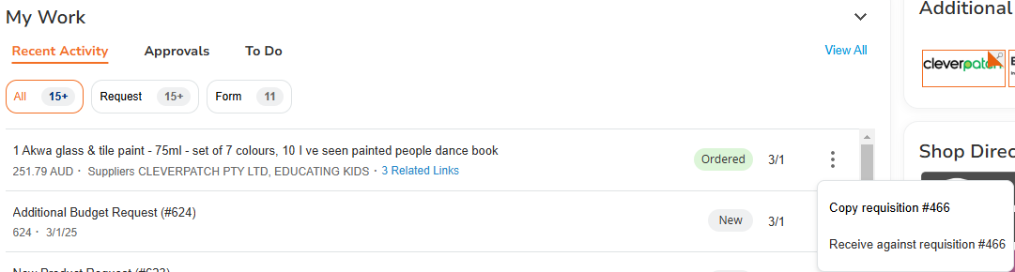
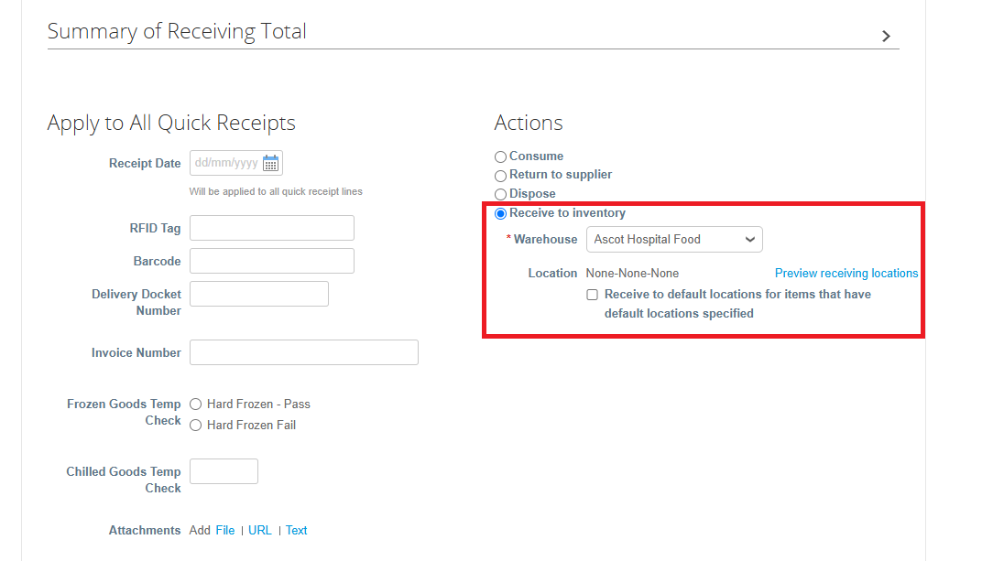
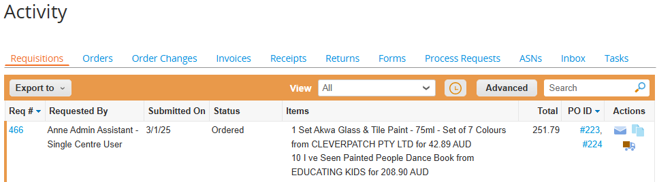
RECEIPTING
Receipting can be actioned once the goods have been received or when an invoice has been uploaded into Coupa and is in ‘Pending Receipt’ status.
123
To receipt, follow these steps:
Locate the requisition/order from one of the following:
  ‘My Work’ area on the home page: Click the three dots beside the request/order and select ‘Receive against requisition #’.
  ‘Activity’ section at the top right of the home page: Click the Truck icon in the Action column next to the relevant request/order.
Enter the Receipt Date and Quantity for the applicable line items.
Under Actions, select "Receive to Inventory“ and choose the warehouse and location where the items should be stored.
Click Submit to complete the receipting process.
2
1
3

Slide 16
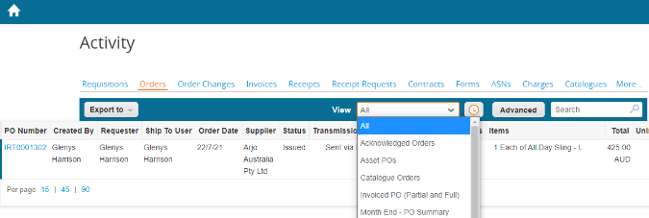



CREATING VIEWS
123
You can filter information by using the ‘View’ functionality in any of the sub menus
Views can be exported into xlsx or csv format
Click on ‘Create View’
Filter using one of the options or create a custom view via ‘Create View’
Data reports are emailed to the user

Slide 17
Q&A / RESOURCES
123
💬 Have questions? Feel free to ask!
Need further assistance? Reach out to us for help.
Support Contacts: 📌 Ian @ Ian.Lai@Doltonehouse.com.au
📌 Diana @ Diana.Imtiaz@Doltonehouse.com.au

