Slide 1

Coupa Accounts Payable Training

Slide 2

INVOICE PROCESS OVERVIEW
Invoices in Coupa can be created either manually by Accounts Payable (AP) or automatically by the supplier through various methods
123
How Invoices Are Created:
Direct Entry – AP enters the invoice manually in Coupa.
CSP (Coupa Supplier Portal) – Suppliers submit invoices through the portal.
SAN (Supplier Actionable Notification) – Suppliers submit invoices directly from the PO email.
cXML (Punchout Suppliers) – Invoices are generated through integrated supplier systems.
Types of Invoices:
PO-Backed Invoices – Linked to an existing purchase order.
Non-PO Backed Invoices – Submitted without referencing a PO.
Credit Notes – Issued to adjust or correct previous invoices.
Coupa also offers AP reporting functionality, allowing users to generate custom reports, such as invoice aging and pending goods receipt reports, to track financial workflows efficiently.

Slide 3
INVOICE PROCESS OVERVIEW
Doltone / Ovation has Coupa-compliant e-invoicing enabled, ensuring that all invoices meet country-specific tax requirements before being issued. Coupa’s tax-compliant software automatically validates invoices and generates a legal PDF invoice, accessible to both us and the supplier.
Note: Suppliers can also upload their own PDF invoice copies if needed.
Invoice Processing & PO Flip
Invoices are raised against purchase orders, with PO details automatically transferred using PO Flip.
Minimal manual intervention speeds up processing and reduces errors.
Two Ways to Issue E-Invoices:
Supplier Actionable Notification (SAN): Create an invoice directly from the Purchase Order email using PO Flip.
Coupa Supplier Portal: Log in and generate an invoice within the portal, linking it to a Purchase Order via PO Flip.
123

Slide 4
INVOICE TOLERANCES
123
PO and Non-PO Backed Invoices
Invoice Date cannot be backdated more than 90 calendar days.
Invoice Tolerance Limits:
  5% or $25 over the original PO amount (whichever is lower).
  5% or $25 over the original PO quantity (whichever is lower).
  Shipping tolerance: $25.
  PO Line Price Amount tolerance: $0.10.
Invoice Tolerance & Approval Process – 3-Way Matching
If an invoice exceeds the relevant PO line value, Coupa checks against tolerance rules:
  If within 5% or $10 (whichever is lower), the invoice can be processed for payment—provided a matching receipt has been submitted.
  If exceeding tolerance, the invoice status will be ‘Pending Approval’ and will require manual approval before processing.
  Coupa first checks for a receipt, so the initial status may be ‘Pending Receipt’, followed by ‘Pending Approval’ if tolerance is exceeded.

Slide 5
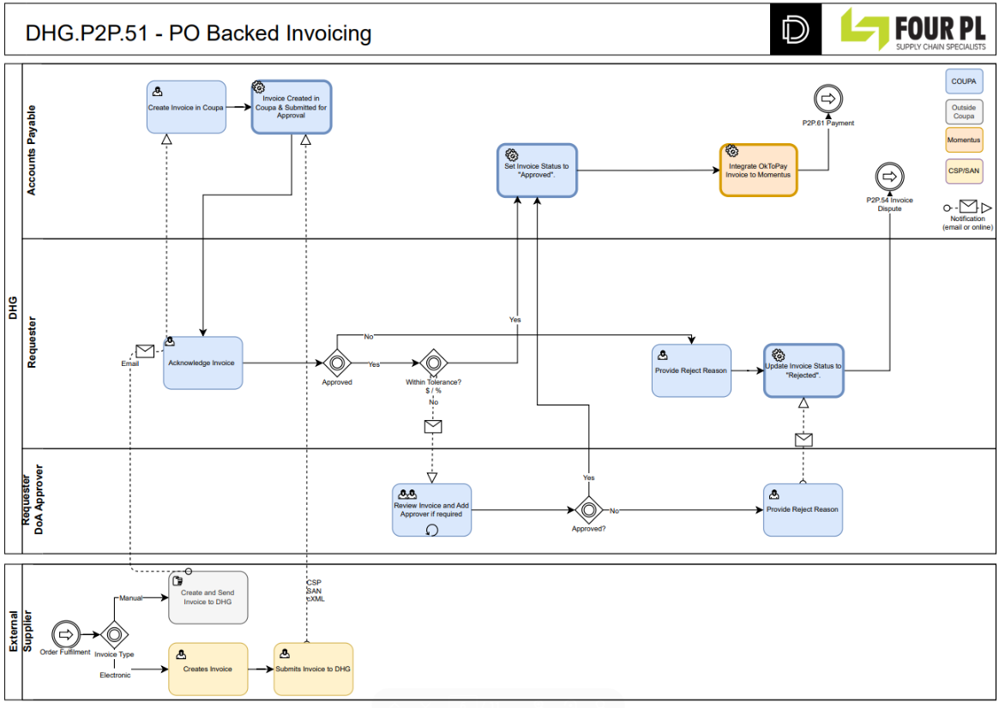
OVERVIEW – PO BACKED INVOICING
123

Slide 6
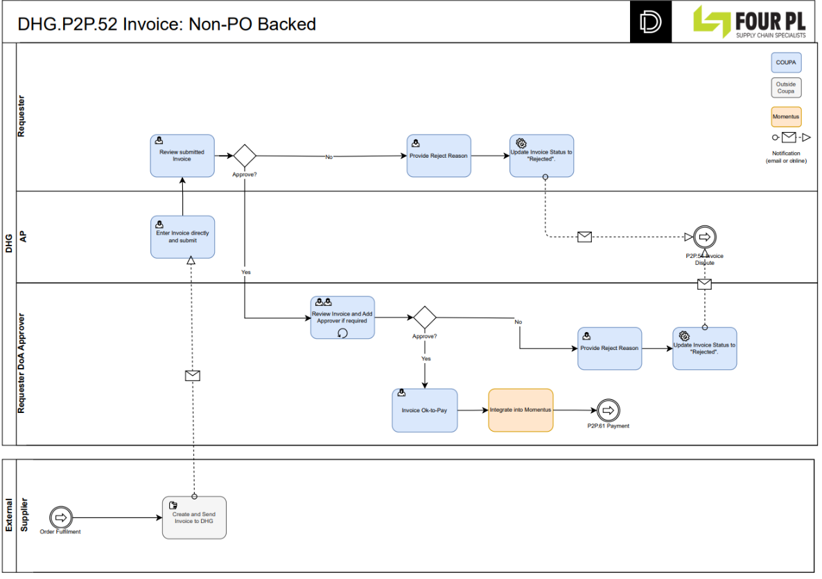
OVERVIEW – NON PO BACKED INVOICING
123

Slide 7
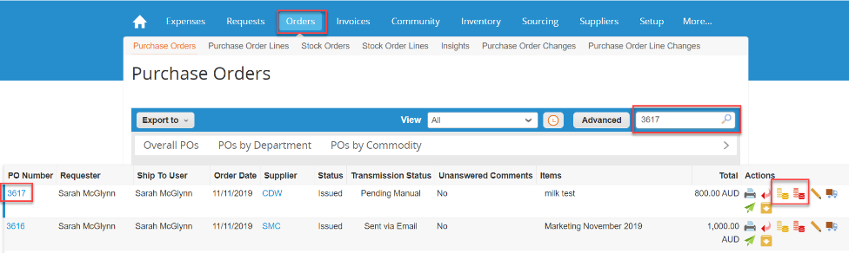

CREATING AN INVOICE – PO FLIP
PO Flip & Invoice Creation
PO Flip allows you to create an invoice directly from a Purchase Order (PO).
AP can search for the required PO number in Coupa.
In the Actions section of the PO, they can click the Gold Coin Stack 🟡 to generate an invoice, automatically pulling information from the PO.
To create a Credit Note, AP should select the Red Coin Stack 🔴 instead.
123

Slide 8
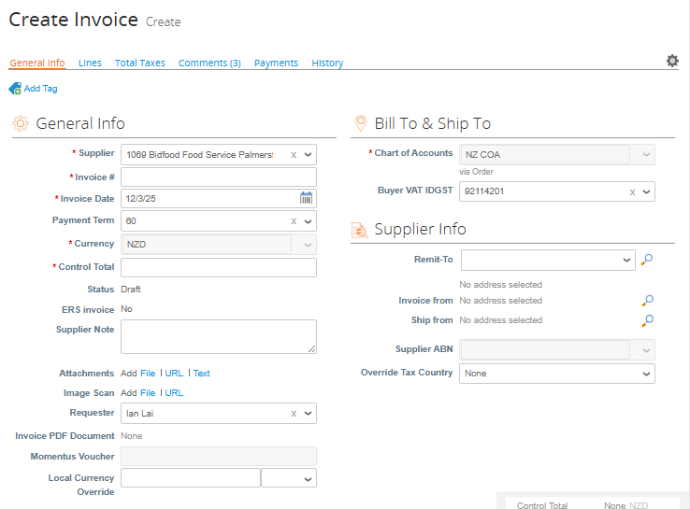
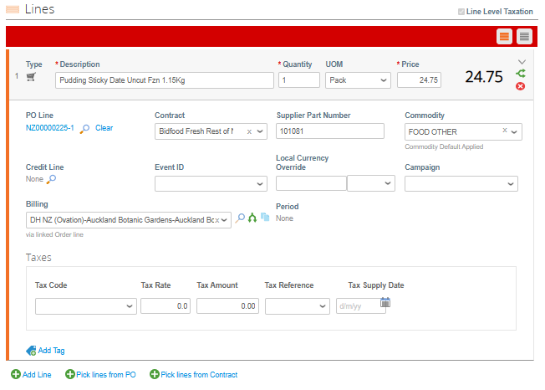
CREATING AN INVOICE – PO FLIP
123
Fields marked with a red * are mandatory and must be completed.
A copy of the invoice MUST be attached to the entry.
Select the relevant line(s) from the PO for the invoice.
Review and update line values, quantities, and tax codes to ensure they match the supplier’s invoice.
Delete any PO lines that are not included on the supplier’s invoice.

Slide 9
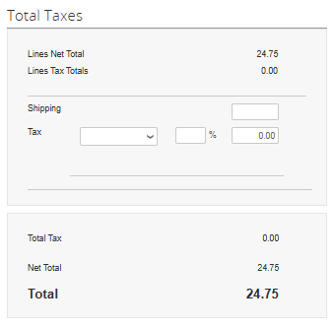
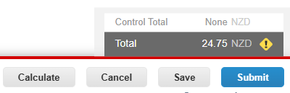
CREATING AN INVOICE – PO FLIP
Enter shipping fees if applicable.
Click Calculate to verify the invoice entry against the actual invoice total (Control Total).
Once reviewed, click Submit to process the invoice.
The 2-way or 3-way matching process will determine if the invoice moves to ‘Approved’ status and integrates into Momentus for payment.
If the invoice does not meet auto-matching conditions, it will be assigned a status requiring action, such as ‘Pending Receipt’ or ‘Pending Approval’.
123

Slide 10
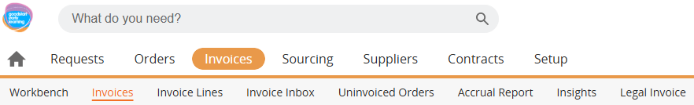
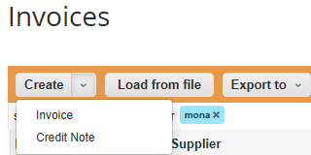
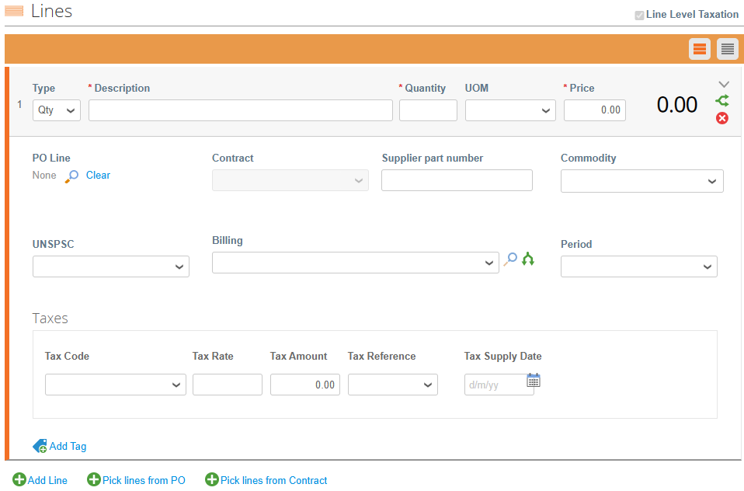
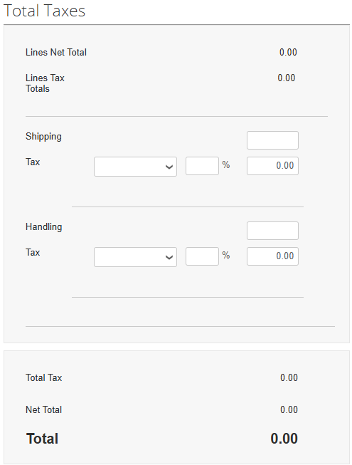
CREATING AN INVOICE/CREDIT NOTE – NON-PO BACKED
Invoice Entry Guidelines
Ensure all required information from the supplier invoice is entered accurately.
Line-Level Details:
Add Line – Click to add additional line items.
Type – Specifies whether the line item is quantity-based or amount-based.
Description – Enter a brief description of the line item.
Qty – Input the quantity (leave blank for amount-based lines).
UOM (Unit of Measure) – Select the appropriate unit (blank for amount-based lines).
Price – Enter the price per unit (GST exclusive).
Contract – Select an applicable contract if available.
Billing – Choose the billing account fields (some fields auto-populate).
To split bill, click the split billing icon.
Final Steps:
Select Calculate to verify the invoice entry against the actual invoice total (Control Total).
Once reviewed, click Submit to process the invoice.
123
*If creating a credit note:
For quantity-based lines, enter a negative quantity. For amount-based lines, enter a negative price.

Slide 11
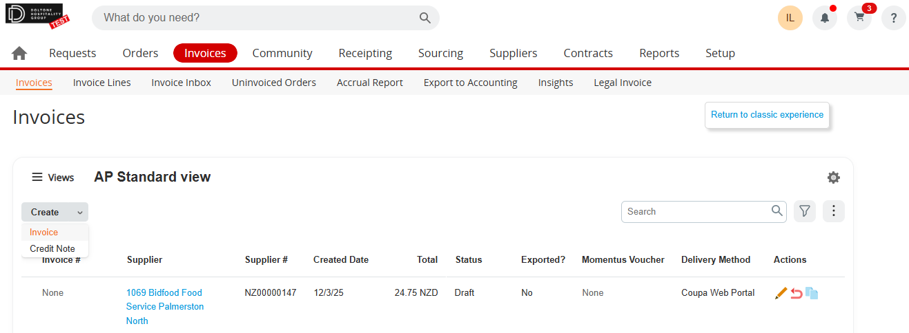
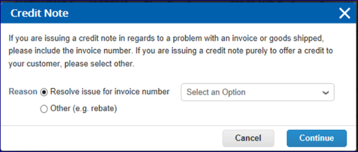
CREATE A CREDIT NOTE – PO FLIP OR MANUAL
Creating a Credit Note
A credit note is created similarly to an invoice using PO Flip (red coins) or manually:
Create → Credit Note
Ensure a negative quantity or price is entered to issue the credit.
Wherever possible, raise a Credit Note against a previously entered invoice (exceptions apply, e.g., rebates).
Key Notes:
To fully cancel an invoice, only the following fields can be edited: Credit Note Date, Credit Note Number, and Credit Reason.
All other fields are pre-populated and not editable, ensuring information carries over from the original invoice.
If adjustments to invoice lines are needed, you can edit: Credit Note Date, Credit Note Number, Credit Reason, and line adjustment details (e.g., price and quantity).
123

Slide 12
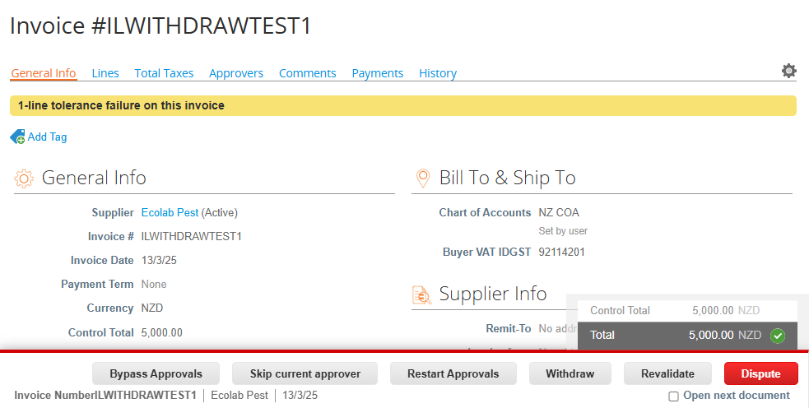
WITHDRAWING INVOICES
Withdrawing an Invoice
Only AP-created invoices can be withdrawn; supplier-created invoices cannot be withdrawn.
Open the relevant invoice, scroll down, and select Withdraw (may be under More Actions).
Once withdrawn, the invoice moves to Draft status, allowing you to edit and re-submit if needed.
123

Slide 13
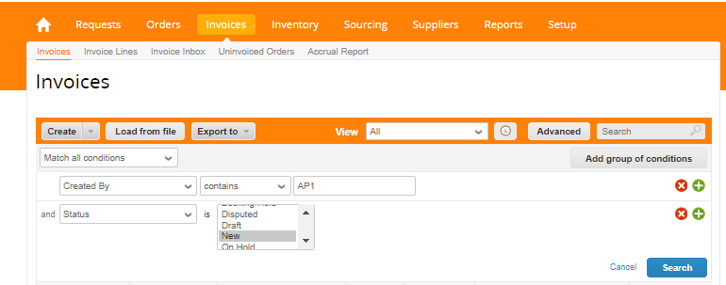
DELETING INVOICES
Searching and Deleting an Invoice
Use the Advanced Search field to find an invoice by number, supplier, or status.
If you created the invoice, it will be listed under your name.
AP can only delete invoices that were AP-created and are in ‘New’ status.
To delete an invoice, open it, then select Delete.
123

Slide 14
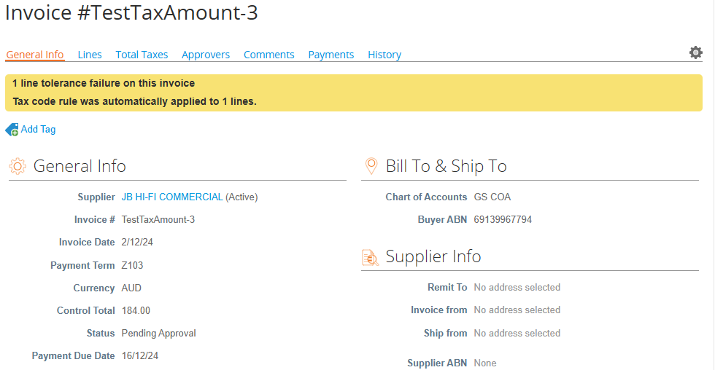
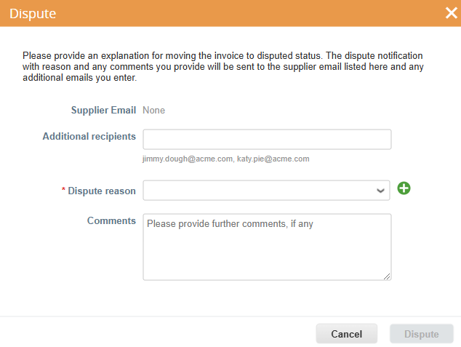

INVOICES – REJECTING / DISPUTING
123
Invoices may have the option to Reject or Dispute.
Dispute triggers a pop-up to send an email to the supplier.
Important:
Use Dispute only for invoices uploaded via the Coupa Supplier Portal when supplier changes or updates are needed (e.g., incorrect invoices that cannot be processed).
Do not use Dispute for Non-PO Backed invoices uploaded by Accounts Payable.

Slide 15
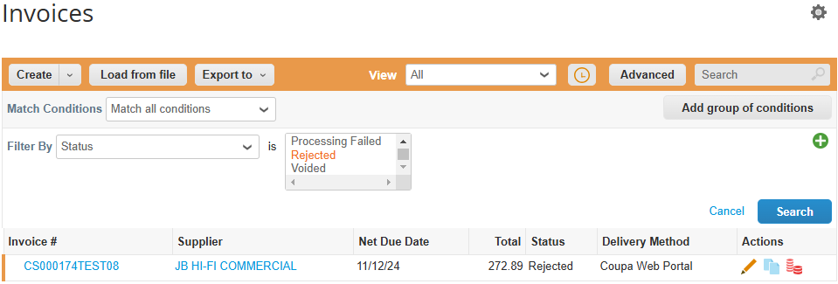
INVOICES – REJECTING / DISPUTING
123
Internal users can reject invoices while they are in Pending Approval status.
Once rejected, the invoice status changes to ‘Rejected’.
The AP team must review and take action, either by:
Disputing the invoice to send it back to the supplier (if uploaded via the Coupa Supplier Portal).
Editing the invoice and taking the necessary corrective action.

Slide 16
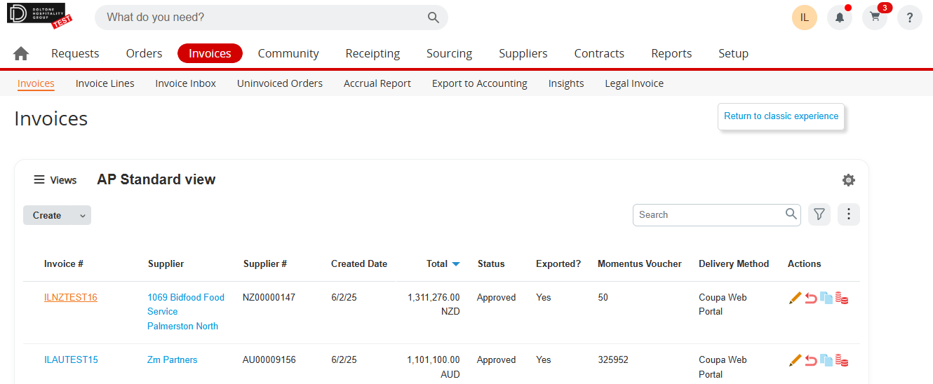
INVOICES - VOIDING
Locate the relevant invoice from the Invoices screen.
Click the Void icon and confirm the action.
Note:
Only users with the Accounting Supervisor role can void invoices in Draft, Pending Receipt, Approved, or Disputed status.
123

Slide 17
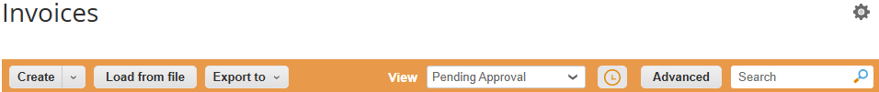
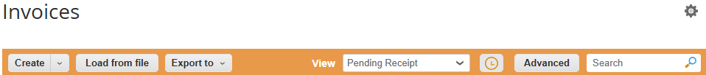
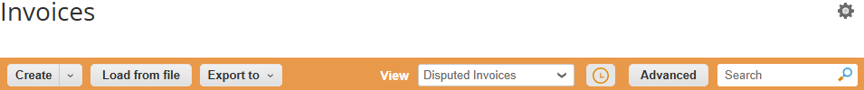
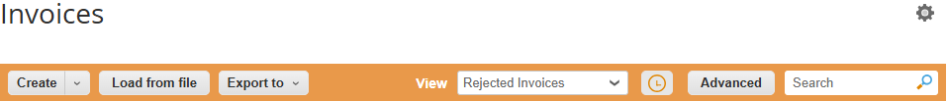
USEFUL VIEWS / REPORTS
PENDING APPROVAL
This report displays all invoices that are pending approval.
Invoices → Invoices → Pending Approval
123
PENDING RECEIPT
This report displays all invoices that are pending receipt, along with the Requester who must confirm the receipt.
Invoices → Invoices → Pending Receipt
DISPUTED INVOICES
This report displays all invoices that have been disputed, along with the dispute reason.
Invoices → Invoices → Disputed Invoices
REJECTED INVOICES
This report displays all invoices that have been rejected and are waiting further action by AP.
Invoices → Invoices → Rejected Invoices

Slide 18
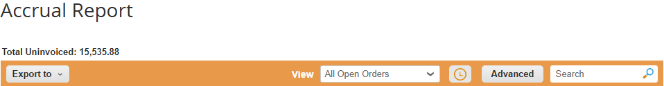
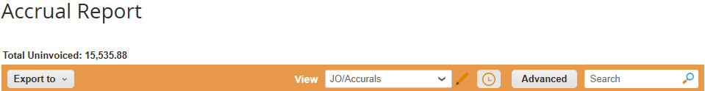
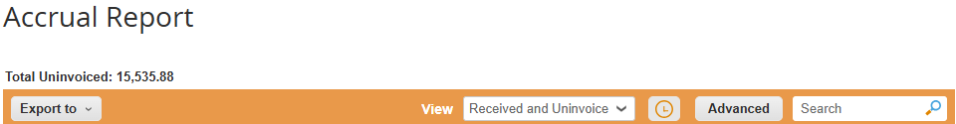
USEFUL VIEWS / REPORTS
OPEN ORDERS
This report displays all purchase orders that are open, and still able to be invoiced against.
Invoices → Accrual Report → All Open Orders
123
ACCRUALS
This report displays all purchase orders that are open, and still able to be invoiced against, including account billing information.
Invoices → Accrual Report → JO/Accruals
PENDING APPROVAL & PENDING RECEIPT
This report displays all invoices that have been processed in Coupa but are still waiting approval or receipt and therefore have not yet been integrated into Momentus.
Invoices → Invoices → Pending Approval / Pending Receipt
RECEIVED AND UNINVOICED
This report displays all purchase orders that have been received but invoices are not yet received.
Invoices → Accrual Report → Received and Uninvoiced

Slide 19
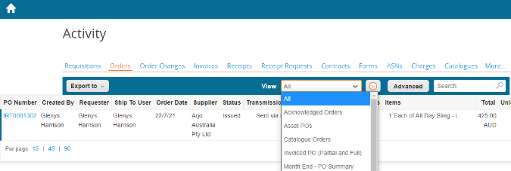



CREATING VIEWS
123
You can filter information by using the ‘View’ functionality in any of the sub menus
Views can be exported into xlsx or csv format
Click on ‘Create View’
Filter using one of the options or create a custom view via ‘Create View’
Data reports are emailed to the user
Coupa Accounts Payable Training
19

Slide 20
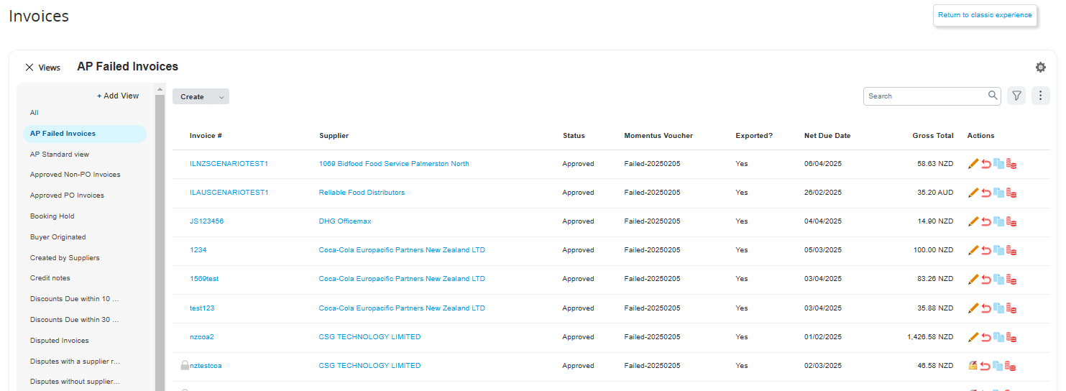
INTEGRATION ERROR MONITORING
Invoices may fail to export to Momentus due to various reasons. It is critical for AP to monitor failed integrations daily, resolve any issues, and reprocess them for export. If invoices remain unresolved in Coupa, it could potentially lead to late payments, unhappy suppliers etc.
Daily Monitoring Process:
Use the designated View to filter for invoices where Momentus Voucher Number is marked as ‘Failed’.
123

Slide 21
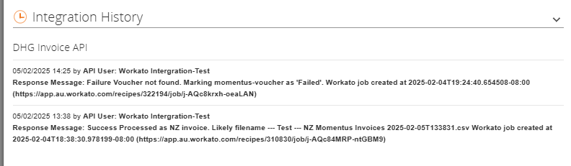
INTEGRATION ERROR MONITORING
Scroll to the bottom and open the Integration History section. Review the error message to identify the reason for the failure.
Example Issue:
If the error relates to an invalid Billing String, update it to a valid and active GL code.
Fixing the Error:
Edit the invoice.
Update the Billing String with a valid GL code.
Save and Submit the invoice for reprocessing.
Note: If you're unsure how to resolve a specific error, please contact me or Diana for assistance.
123

Slide 22
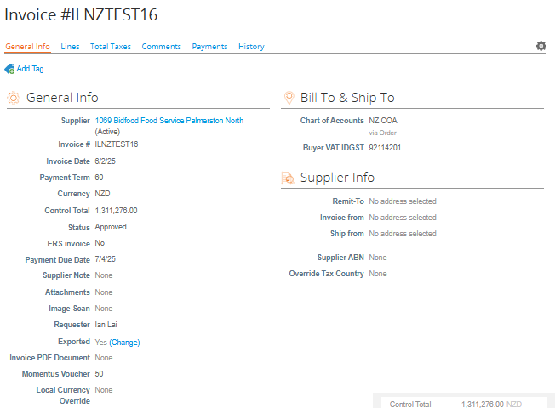
INTEGRATION ERROR MONITORING
123
3. After fixing the issue causing the failure, navigate to the Header section of the invoice.
  Locate the Exported flag, which will be set to Yes.
  Click Change to update the flag from Yes to No.
Once updated, the invoice will be automatically picked up for export during the next integration run.

Slide 23
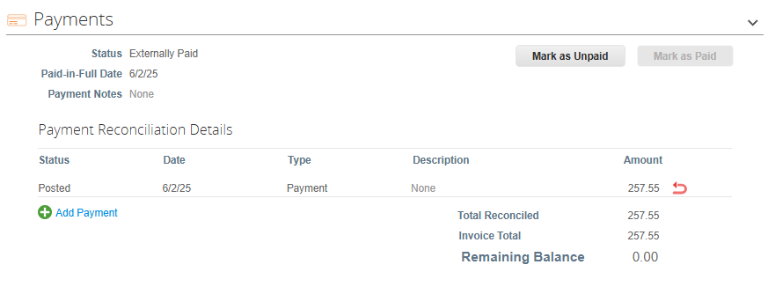
PAYMENT STATUS
Thanks to Momentus' integration with Coupa, you can easily check if an invoice has been paid. Simply scroll to the bottom of the invoice, where the system will display the payment status and payment date if applicable.
123

Slide 24
Q&A / RESOURCES
123
💬 Have questions? Feel free to ask!
Need further assistance? Reach out to us for help.
Support Contacts: 📌 Ian @ Ian.Lai@Doltonehouse.com.au
📌 Diana @ Diana.Imtiaz@Doltonehouse.com.au

