Slide 1

Coupa Procurement Training

Slide 2
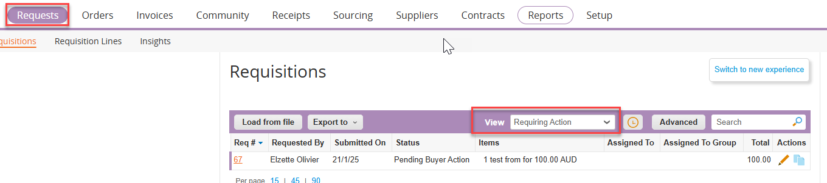
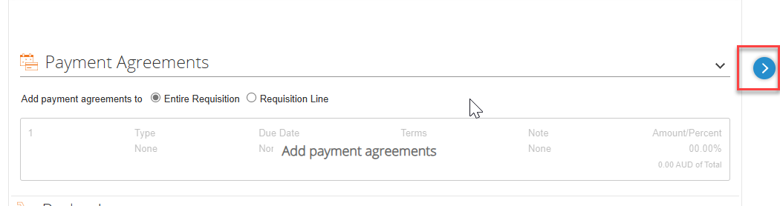
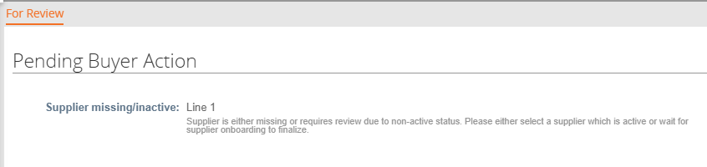
PENDING BUYER ACTION ITEMS
In some cases, Coupa allows requisitions to be submitted even if a Purchase Order cannot be created due to missing information, such as a missing supplier.
When this occurs, the requisition moves to Pending Buyer Action, meaning Buyers must resolve the issue before it can proceed for approval.
To find requisitions needing attention, use the Requiring Action view.
123
Editing a Pending Buyer Action Requisition
Click on the Pencil icon to edit the requisition.
To view the reason why the requisition moved to Pending Buyer Action, expand the > arrow within the requisition.

Slide 3
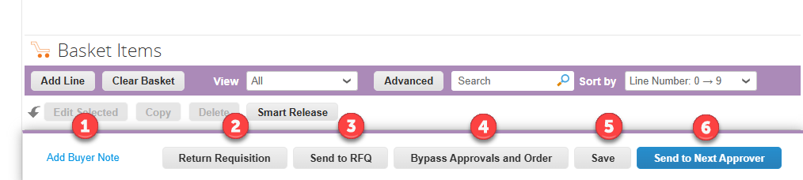
PENDING BUYER ACTION ITEMS
As a Buyer, you can take the following actions:
Create a Buyer Note – Add a note that will be visible during the approval process.
Return the Requisition to the User – Send it back for corrections.
Send to RFQ – Refer to the Spot Buy slides for details.
Bypass Approvals and Order – Proceed with ordering without further approvals.
Save the Requisition – Keep it in draft to return later.
Send to Next Approver – Move the requisition forward in the approval chain.
123

Slide 4
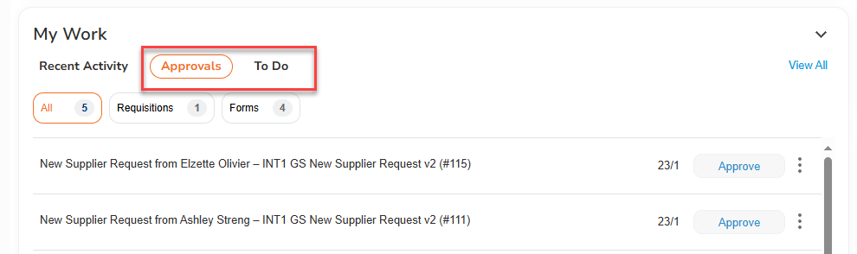
PROCUREMENT REVIEW TASKS
Procurement will receive multiple tasks for review, including:
Free Text Requests
Team Performance Payment Requisitions
Catalogue Orders
To access approval tasks:
Use the Approvals or To-Do List on the home page.
Create custom views in different tabs for better organization.
The Inbox will contain all approval tasks in one place.
123

Slide 5
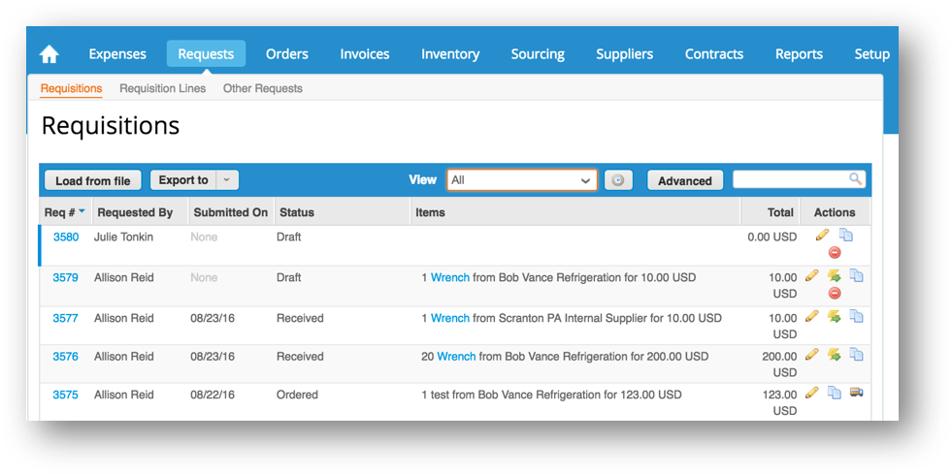
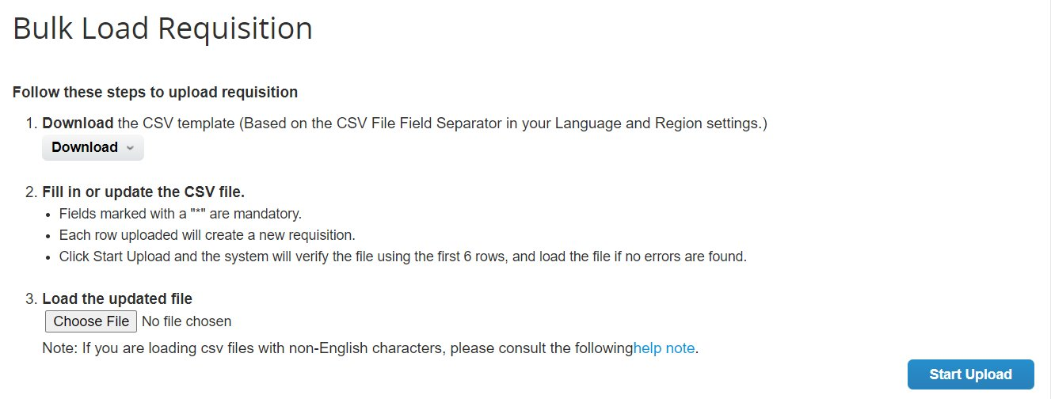
BULK LOADING REQUISITIONS
Coupa allows users to bulk load requisitions, making it easier for those who create multiple requisitions regularly or need to upload requisitions with many line items.
Steps to Bulk Load Requisitions:
Navigate to the Requests page.
Click on the Load from File button.
Select the file and click Start Upload.
123

Slide 6
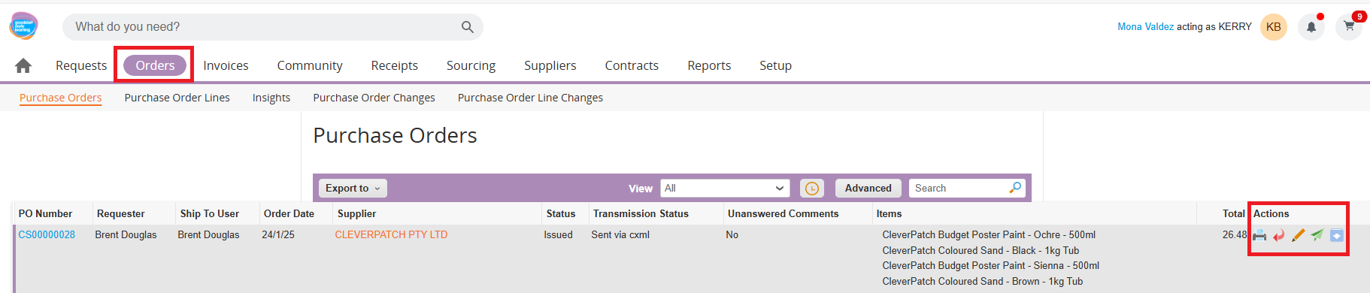
PO ACTIONS
Only users with the Buyer role can perform PO actions in Coupa.
PO Actions (Orders Page):
Print PO – Generate a printable copy of the Purchase Order.
Cancel PO – Cancel the PO if it is no longer needed.
Revise PO – Edit and update the PO details as required.
Send PO – Send the PO to the supplier.
Soft Close PO – Temporarily close the PO while keeping the option to reopen if needed.
Once a PO has been soft closed, only Buyers can:
Close PO – Permanently close the PO.
Reopen PO – Reactivate a previously closed PO.
123

Slide 7
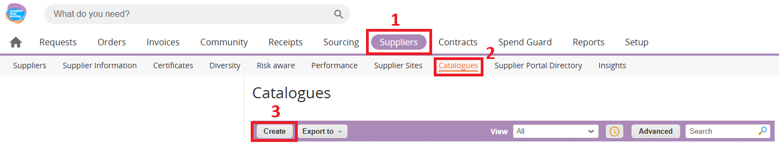
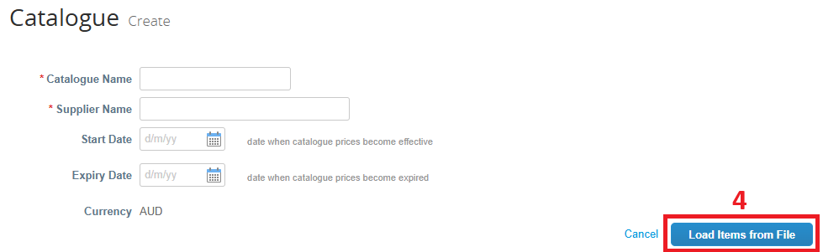

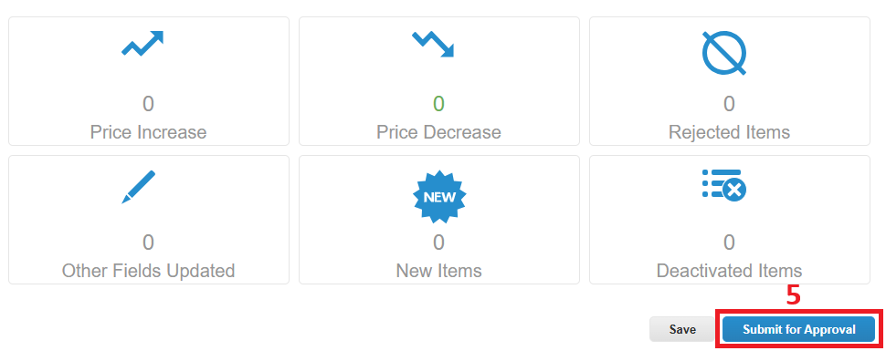
LOADING SUPPLIER CATALOGUES
Only users with the Buyer role can load supplier catalogues in Coupa.
Steps to Load a Supplier Catalogue:
Navigate to the Suppliers page.
Click on Catalogues.
Select the Create button.
Enter the following details:
  Catalogue Name
  Supplier Name
  Start & End Dates
Click Load Items from File and upload the catalogue.
Once uploaded, click Submit for Approval.
After submission, the Procurement team will review and approve the catalogue before it becomes active.
123

Slide 8
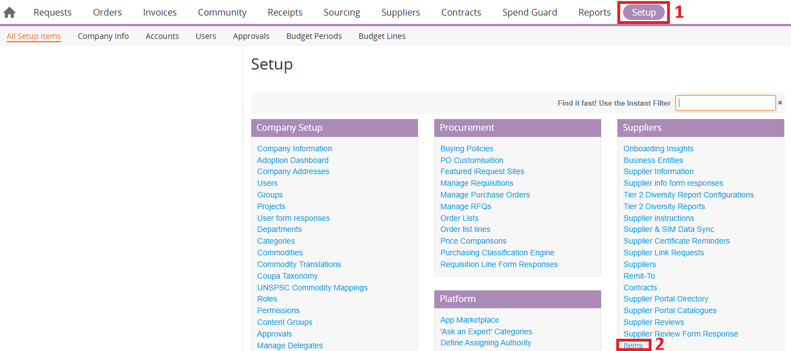
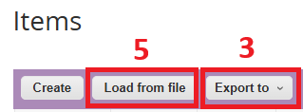
APPROVAL METHODS
Once supplier catalogues have been loaded and approved, Buyers must validate the data to ensure completeness and accuracy. This includes checking for missing UNSPSC to Commodity mappings, as well as adding Tags and Funding Types.
Steps to Validate & Update Catalogue Items:
Navigate to the Setup page.
Click on Items.
Select the Export button to download the item data.
Review and update details such as:
  Commodity
  UNSPSC Code
  Tags
  Funding Type
Once all updates are made, reload the updated file into Coupa.
123

Slide 9
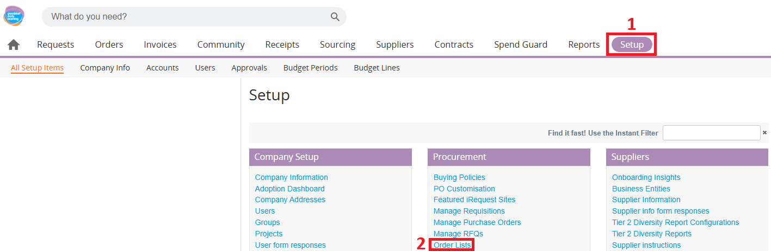
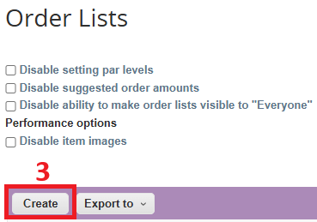
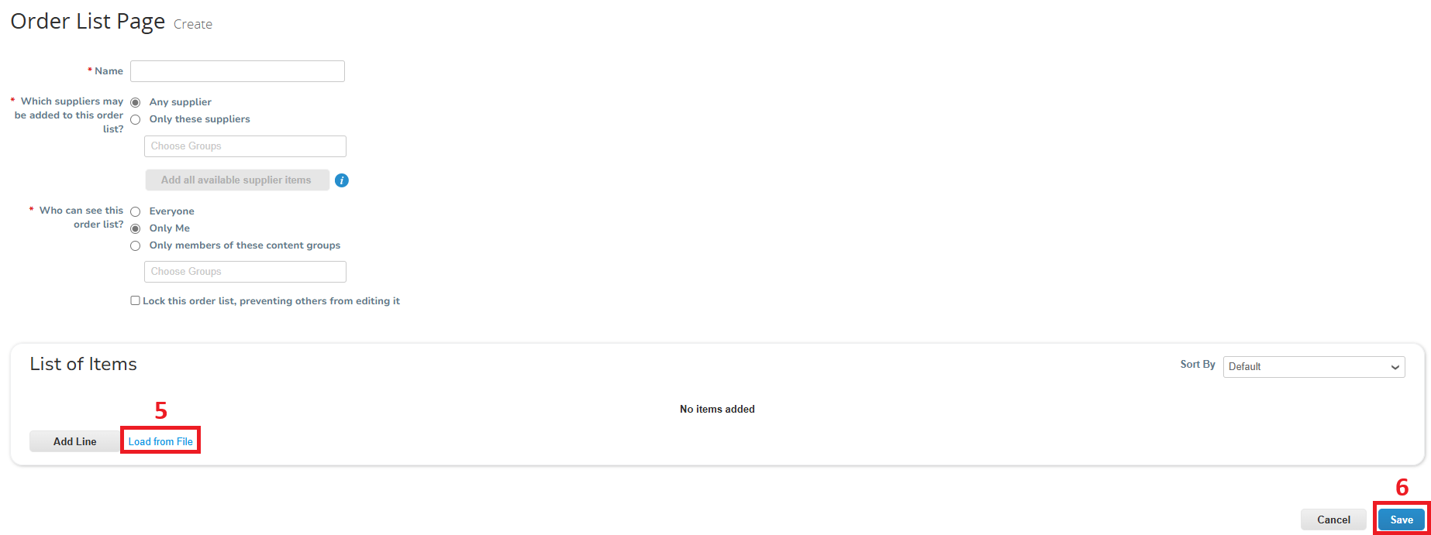
ORDER LISTS
After catalogues and items have been loaded or updated, Buyers must create Order Lists to organize and manage purchasing efficiently.
Steps to Create an Order List:
Navigate to the Setup page.
Click on Order Lists.
Select the Create button.
Enter the required details:
  Order List Name
  Supplier(s)
  Content Group
  Other relevant information
Click Load from File to upload items to the list.
Click Save to finalize the Order List.
123

Slide 10
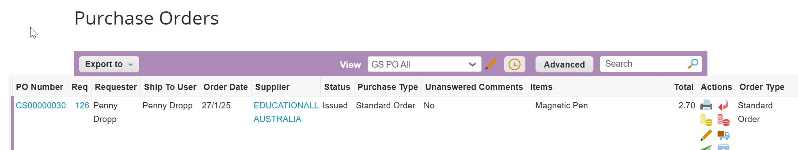
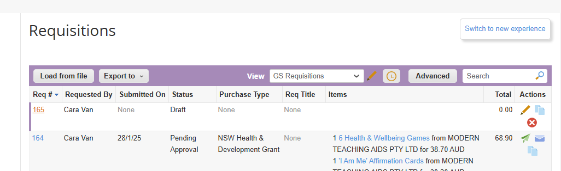
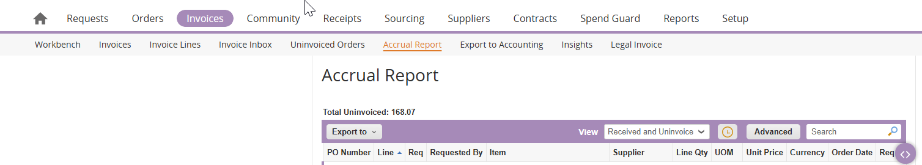
USEFUL VIEWS / REPORTS
PURCHASE ORDERS
Purchase Orders –> PO All
This report displays all purchase orders with their purchase type
123
REQUISITIONS
Requisitions -> Requisitions
This report shows all requisitions including the Purchase Type and Requisition Title
ACCRUAL REPORT
Invoices → Accrual Report -> Received and Uninvoiced
This report shows all invoices including the orders that are received but are uninvoiced

Slide 11
Q&A / RESOURCES
123
💬 Have questions? Feel free to ask!
Need further assistance? Reach out to us for help.
Support Contacts: 📌 Ian @ Ian.Lai@Doltonehouse.com.au
📌 Diana @ Diana.Imtiaz@Doltonehouse.com.au

